Slide 1
Bayesian Data Analysis
Andrew Gelman, John B. Carlin, Hal S. Stern, David B Dunson
Aki Vehtari, Donald B. Rubin

Slide 2
Part I: Fundamentals of Bayesian Inference
Chapter 1 Probability and Inference

Slide 3
1.1 The three steps of Bayesian data analysis
1. Setting up a full probability model.
A joint probability distribution for all quantities in a problem, which should be consistent with the knowledge about the underlying question.
2. Conditioning on observed data.
Calculate and interpret the appropriate posterior distribution, given the observed data.
3. Evaluate the fit of the model and implications of the resulting posterior distribution
Why Bayesian?
Interval estimation > hypothesis testing recently

Slide 4



1.3 Bayesian Inference
Prior predictive distribution
Posterior density (distribution)
Unnormalized posterior density

Slide 5
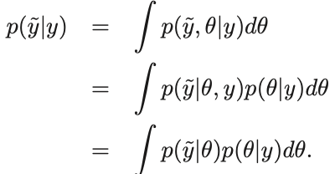

1.3 Bayesian Inference
Posterior predictive distribution
It’s an average of conditional predictions over the posterior distribution.
Odds
The ratio of the posterior density $P\left(θ | y\right)$ at the points $θ_{1}$ and $θ_{2}$
Posterior odds are equal to prior pods multiplied by the likelihood ratio.

Slide 6
Part I: Fundamentals of Bayesian Inference
Chapter 3 Introduction to Multiparameter Models

Slide 7
3.8 Summary of elementary modeling and computation
1. When there are few parameters, posterior inference in nonconjugate multiparameter models can be obtained by simple simulation methods.
2. Sophisticated models can often be represented in a hierarchical or conditional manner.
3. We can often apply a normal approximation to the posterior distribution, and therefore conjugate structure of the normal model can plan an important role in practice.

Slide 8
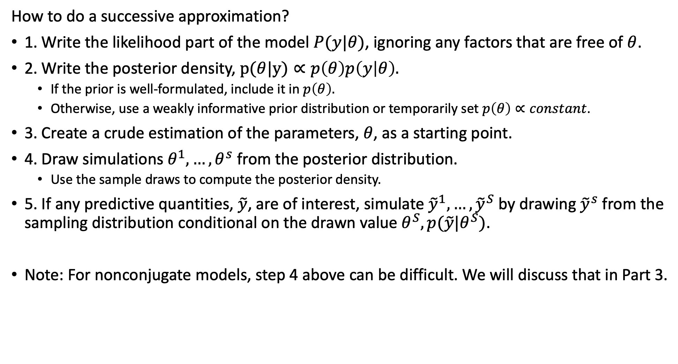
3.8 Summary of elementary modeling and computation
How to do a successive approximation?
1. Write the likelihood part of the model $P(y|θ)$, ignoring any factors that are free of $θ$.
2. Write the posterior density, $p(θ|y)∝p\left(θ\right)p\left(y | θ\right).$
If the prior is well-formulated, include it in $p\left(θ\right).$
Otherwise, use a weakly informative prior distribution or temporarily set $p\left(θ\right)∝constant$.
3. Create a crude estimation of the parameters, $θ$, as a starting point.
4. Draw simulations $θ^{1}, …, θ^{s}$ from the posterior distribution.
Use the sample draws to compute the posterior density.
5. If any predictive quantities, $\tilde{y}$, are of interest, simulate ${\tilde{y}}^{1}, …, {\tilde{y}}^{S}$ by drawing ${\tilde{y}}^{s}$ from the sampling distribution conditional on the drawn value$θ^{S}, p(\tilde{y}|θ^{S})$.
Note: For nonconjugate models, step 4 above can be difficult. We will discuss that in Part 3.

Slide 9
Part I: Fundamentals of Bayesian Inference
Chapter 5 Hierarchical Models

Slide 10
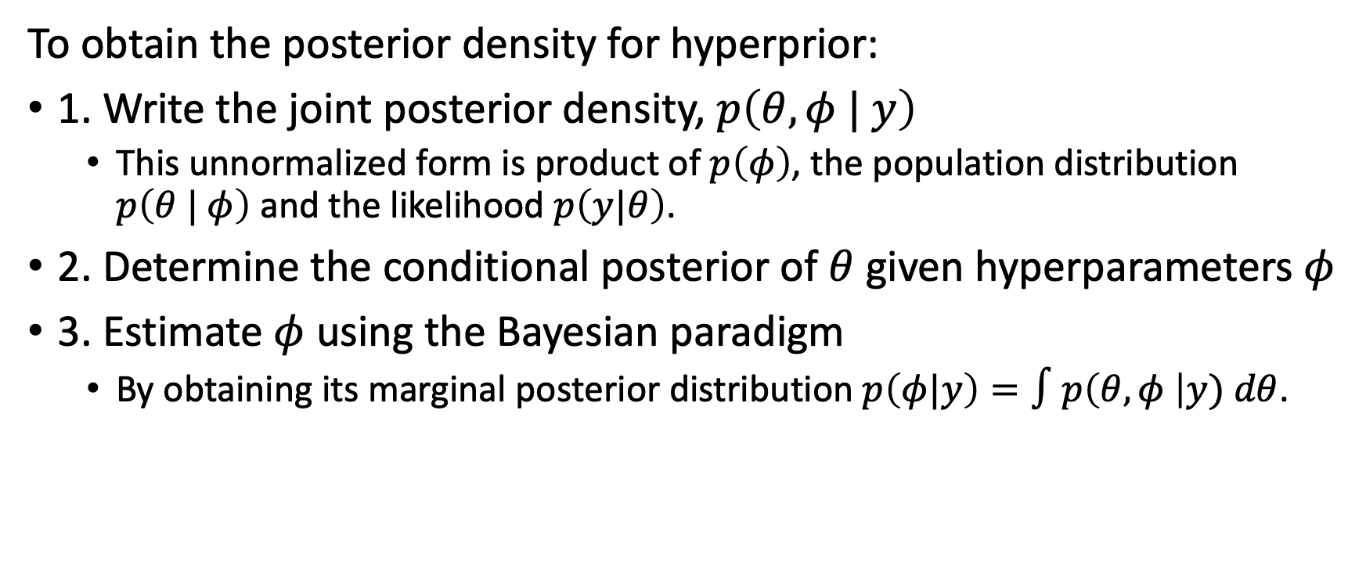
5.3 Bayesian analysis of conjugate hierarchical models
To obtain the posterior density for hyperprior:
1. Write the joint posterior density, $p\left(θ, φ | y\right)$
This unnormalized form is product of $p\left(φ\right)$, the population distribution $p\left(θ | φ\right)$ and the likelihood $p\left(y|θ\right)$.
2. Determine the conditional posterior of $θ$ given hyperparameters $φ$
3. Estimate $φ$ using the Bayesian paradigm
By obtaining its marginal posterior distribution $p\left(φ|y\right)=∫p\left(θ, φ \right|y) dθ$.

Slide 11
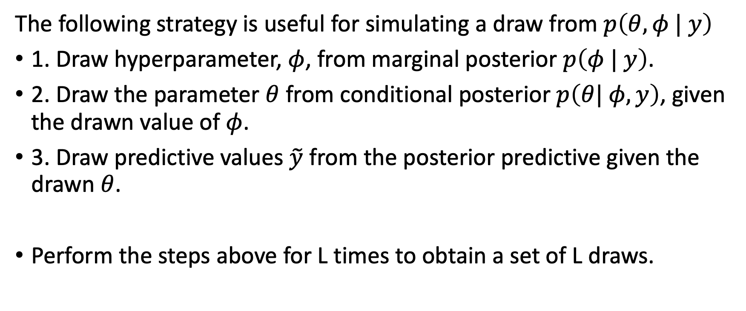
5.3 Bayesian analysis of conjugate hierarchical models
The following strategy is useful for simulating a draw from $p\left(θ, φ | y\right)$
1. Draw hyperparameter, $φ$, from marginal posterior $p\left(φ | y\right)$.
2. Draw the parameter $θ$ from conditional posterior $p\left(θ| φ, y\right)$, given the drawn value of $φ$.
3. Draw predictive values $\tilde{y}$ from the posterior predictive given the drawn $θ$.
Perform the steps above for L times to obtain a set of L draws.

Slide 12
Part II: Fundamentals of Bayesian Data Analysis
Chapter 6 Model Checking

Slide 13
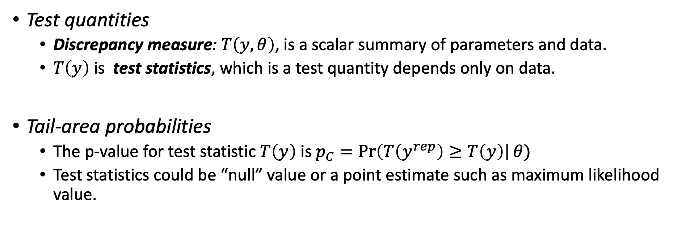
6.3 Posterior Predictive Checking
Test quantities
Discrepancy measure: $T\left(y, θ\right)$, is a scalar summary of parameters and data.
$T\left(y\right)$ is test statistics, which is a test quantity depends only on data.
Tail-area probabilities
The p-value for test statistic $T\left(y\right)$ is $p_{C}=\operatorname{Pr}\left(T\left(y^{rep}\right)≥T\left(y\right)\right|θ)$
Test statistics could be “null” value or a point estimate such as maximum likelihood value.

Slide 14
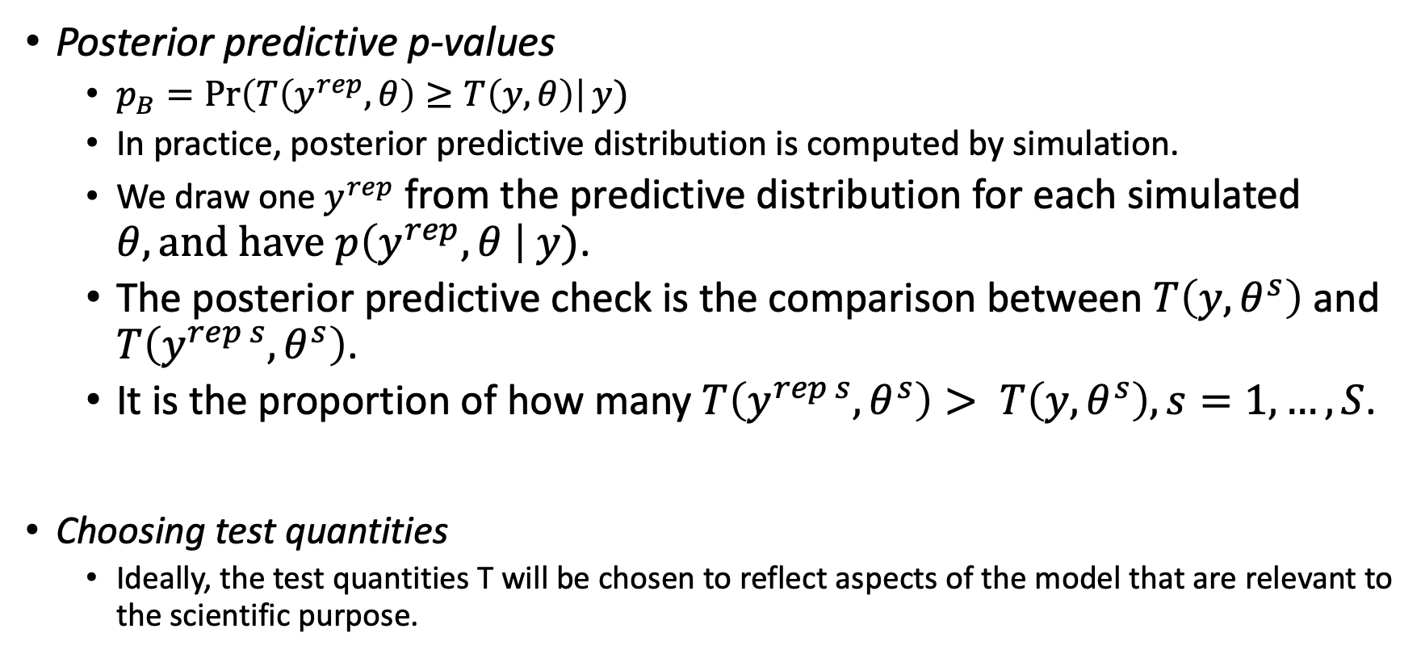
6.3 Posterior Predictive Checking
Posterior predictive p-values
$p_{B}=\operatorname{Pr}\left(T\left(y^{rep}, θ\right)≥T\left(y, θ\right)\right|y)$
In practice, posterior predictive distribution is computed by simulation.
We draw one $y^{rep}$ from the predictive distribution for each simulated $θ, and have$ $p\left(y^{rep}, θ \right| y)$.
The posterior predictive check is the comparison between $T\left(y, θ^{s}\right)$ and $T\left(y^{rep s}, θ^{s}\right)$.
It is the proportion of how many $T\left(y^{rep s}, θ^{s}\right)> T\left(y, θ^{s}\right), s=1, …, S$.
Choosing test quantities
Ideally, the test quantities T will be chosen to reflect aspects of the model that are relevant to the scientific purpose.

Slide 15
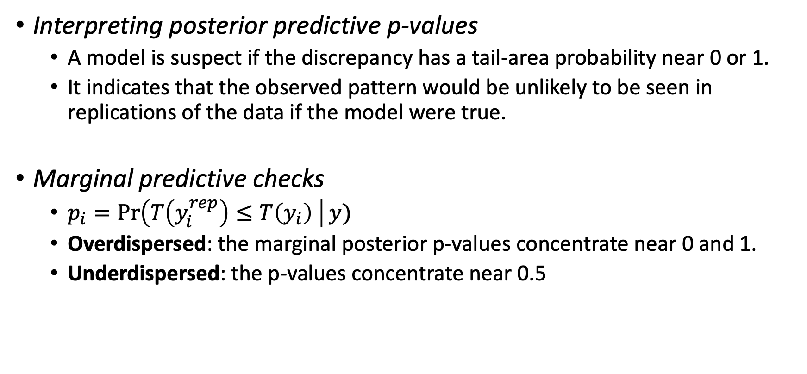
6.3 Posterior Predictive Checking
Interpreting posterior predictive p-values
A model is suspect if the discrepancy has a tail-area probability near 0 or 1.
It indicates that the observed pattern would be unlikely to be seen in replications of the data if the model were true.
Marginal predictive checks
$p_{i}=\operatorname{Pr}\left(T\left(y_{i}^{rep}\right)≤T\left(y_{i}\right) \right|y)$
Overdispersed: the marginal posterior p-values concentrate near 0 and 1.
Underdispersed: the p-values concentrate near 0.5

Slide 16
Part III: Advanced Computation
Chapter 10 Introduction to Bayesian Computation

Slide 17
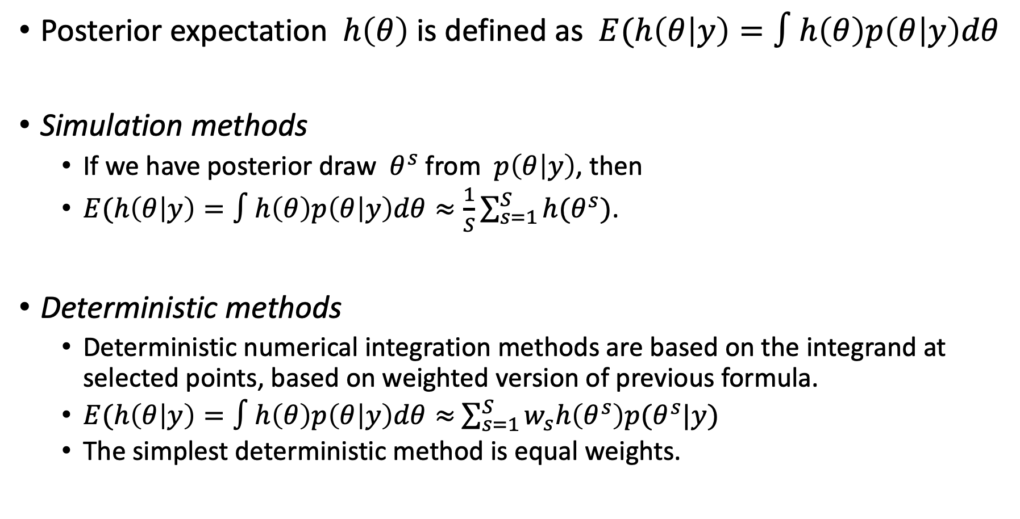
10.1 Numerical Integration
Posterior expectation $h\left(θ\right)$ is defined as $E(h\left(θ | y\right)=∫h\left(θ\right)p\left(θ | y\right)dθ$
Simulation methods
If we have posterior draw $θ^{s}$ from $p\left(θ | y\right)$, then
$E(h\left(θ | y\right)=∫h\left(θ\right)p\left(θ | y\right)dθ≈\frac{1}{S}\sum_{s=1}^{S}{h(θ^{s})}$.
Deterministic methods
Deterministic numerical integration methods are based on the integrand at selected points, based on weighted version of previous formula.
$E(h\left(θ | y\right)=∫h\left(θ\right)p\left(θ | y\right)dθ≈$ $\sum_{s=1}^{S}{w_{s}h\left(θ^{s}\right)p(θ^{s}|y)}$
The simplest deterministic method is equal weights.

Slide 18
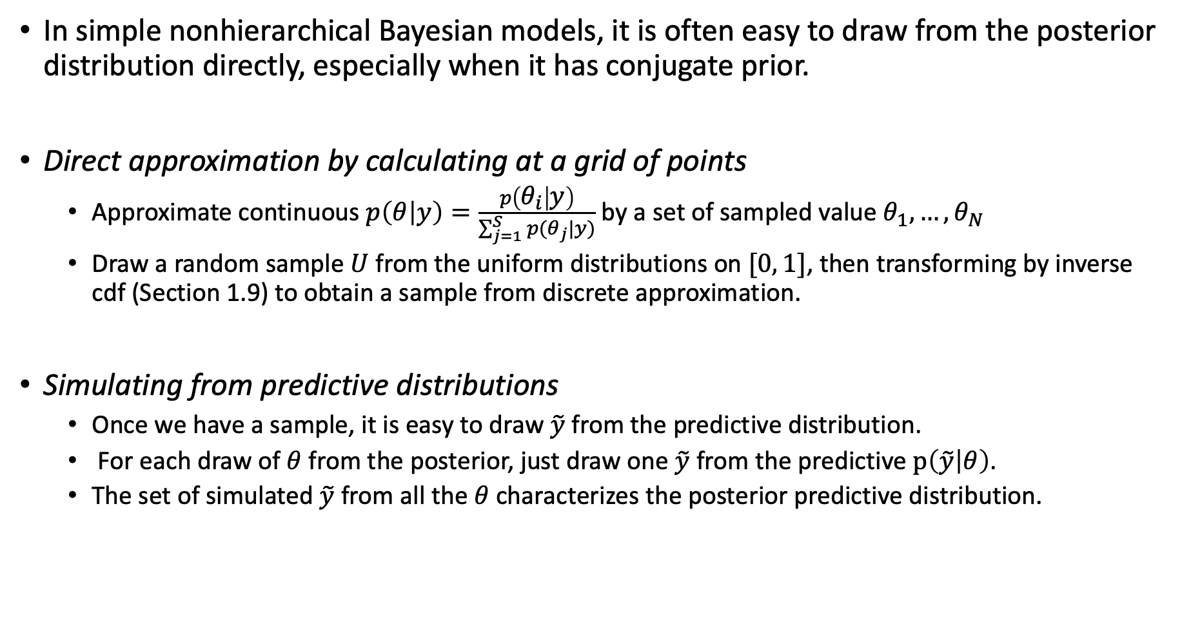
10.3 Direct Simulation and Rejection Sampling
In simple nonhierarchical Bayesian models, it is often easy to draw from the posterior distribution directly, especially when it has conjugate prior.
Direct approximation by calculating at a grid of points
Approximate continuous $p\left(θ | y\right)=\frac{p\left(θ_{i} | y\right)}{\sum_{j=1}^{S}{p(θ_{j}|y)}}$ by a set of sampled value $θ_{1},…, θ_{N}$
Draw a random sample $U$ from the uniform distributions on $[0, 1]$, then transforming by inverse cdf (Section 1.9) to obtain a sample from discrete approximation.
Simulating from predictive distributions
Once we have a sample, it is easy to draw $\tilde{y}$ from the predictive distribution.
For each draw of $θ$ from the posterior, just draw one $\tilde{y}$ from the predictive $p\left(\tilde{y} | θ\right)$.
The set of simulated $\tilde{y}$ from all the $θ$ characterizes the posterior predictive distribution.

Slide 19
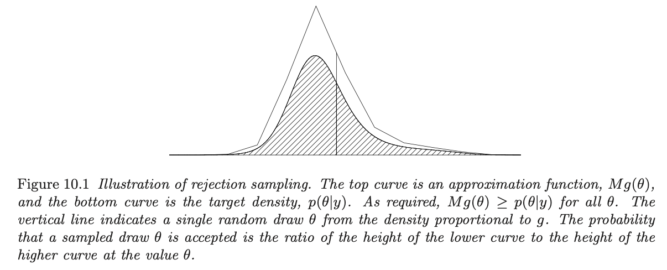

10.3 Direct Simulation and Rejection Sampling
Rejection Sampling
Goal: Obtain a single random draw from a density $p(θ|y)$ or unnormalized density $q(θ|y)$.

Slide 20
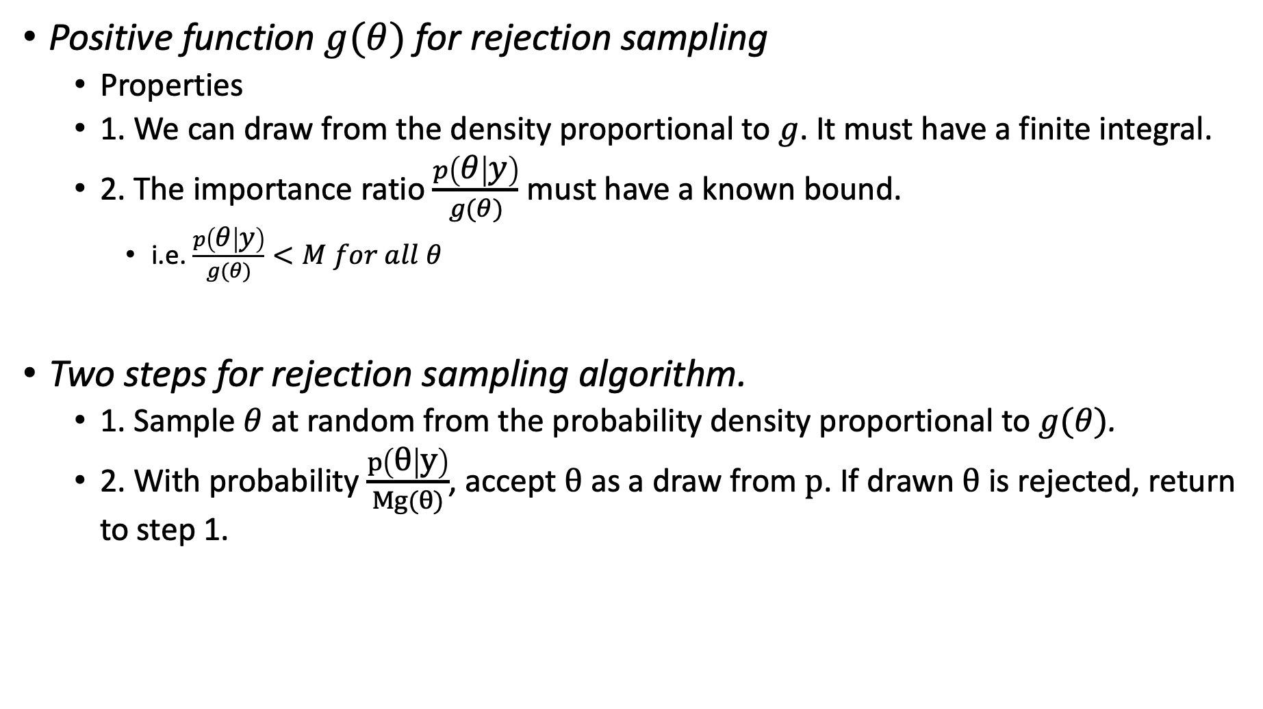
10.3 Direct Simulation and Rejection Sampling
Positive function $g(θ)$ for rejection sampling
Properties
1. We can draw from the density proportional to $g$. It must have a finite integral.
2. The importance ratio $\frac{p\left(θ | y\right)}{g(θ)}$ must have a known bound.
i.e. $\frac{p\left(θ | y\right)}{g(θ)}<M for all θ$
Two steps for rejection sampling algorithm.
1. Sample $θ$ at random from the probability density proportional to $g(θ)$.
2. With probability $\frac{p\left(θ | y\right)}{Mg(θ)}$, accept $θ$ as a draw from $p$. If drawn $θ$ is rejected, return to step 1.

Slide 21
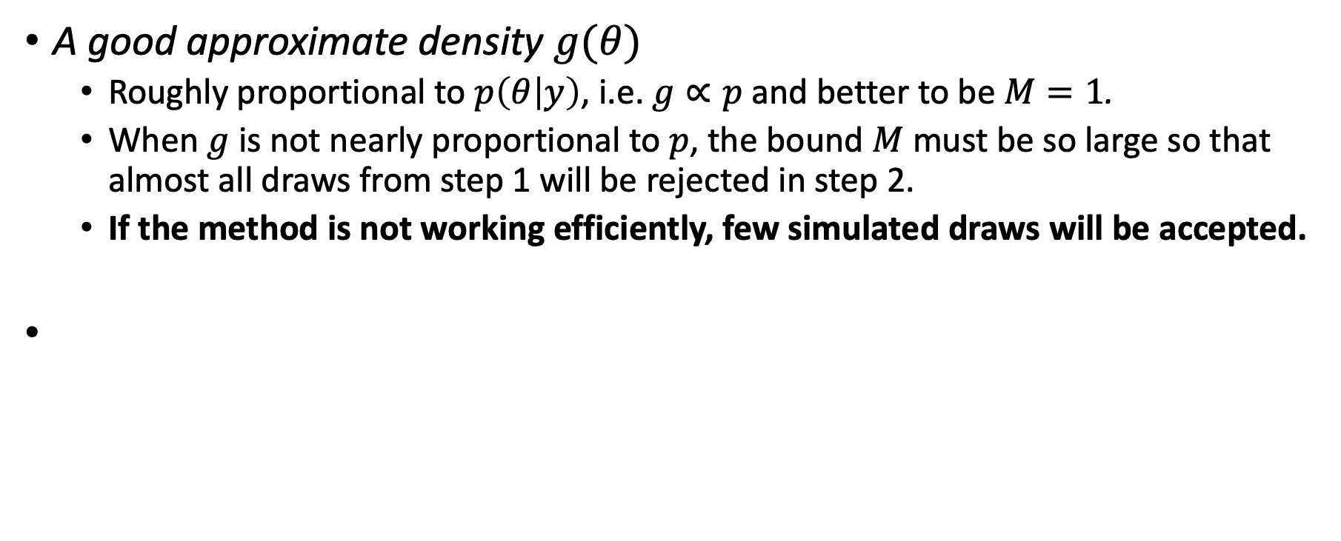
10.3 Direct Simulation and Rejection Sampling
A good approximate density $g(θ)$
Roughly proportional to $p\left(θ | y\right)$, i.e. $g∝p$ and better to be $M=1$.
When $g$ is not nearly proportional to $p$, the bound $M$ must be so large so that almost all draws from step 1 will be rejected in step 2.
If the method is not working efficiently, few simulated draws will be accepted.

Slide 22
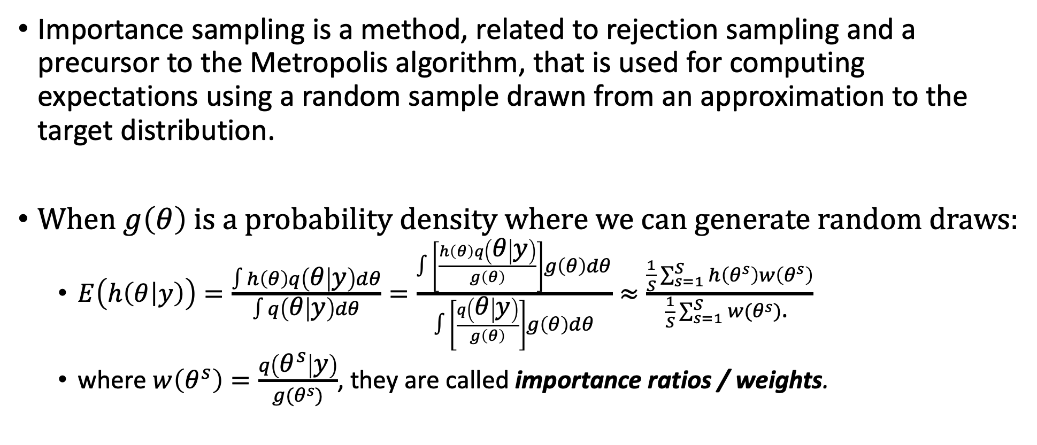
10.4 Importance Sampling
Importance sampling is a method, related to rejection sampling and a precursor to the Metropolis algorithm, that is used for computing expectations using a random sample drawn from an approximation to the target distribution.
When $g\left(θ\right)$ is a probability density where we can generate random draws:
$E\left(h\left(θ | y\right)\right)=\frac{∫h\left(θ\right)q\left(θ | y\right)dθ}{∫q\left(θ | y\right)dθ}=\frac{∫\left[\frac{h\left(θ\right)q\left(θ | y\right)}{g\left(θ\right)}\right]g\left(θ\right)dθ}{∫\left[\frac{q\left(θ | y\right)}{g\left(θ\right)}\right]g\left(θ\right)dθ}≈\frac{\frac{1}{S}\sum_{s=1}^{S}{h\left(θ^{s}\right)w\left(θ^{s}\right)}}{\frac{1}{S}\sum_{s=1}^{S}{w(θ^{s})}\text{. }}$
where $w\left(θ^{s}\right)=\frac{q\left(θ^{s} | y\right)}{g(θ^{s})}$, they are called importance ratios / weights.

Slide 23
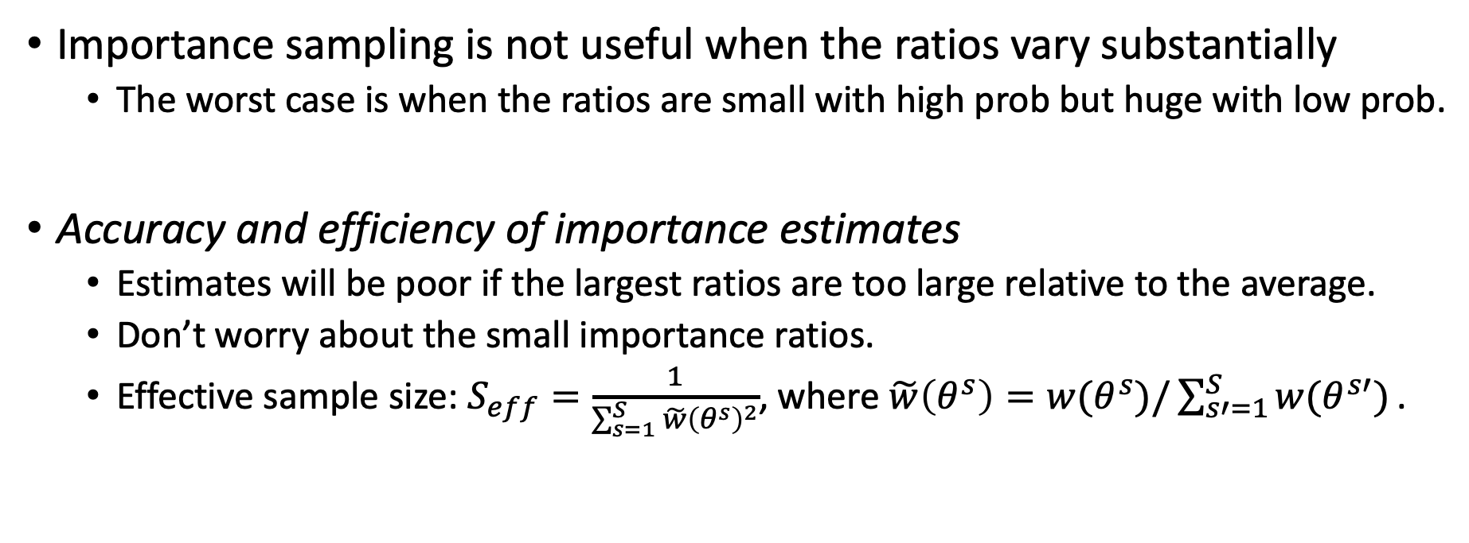
10.4 Importance Sampling
Importance sampling is not useful when the ratios vary substantially
The worst case is when the ratios are small with high prob but huge with low prob.
Accuracy and efficiency of importance estimates
Estimates will be poor if the largest ratios are too large relative to the average.
Don’t worry about the small importance ratios.
Effective sample size: $S_{eff}=\frac{1}{\sum_{s=1}^{S}{\tilde{w}{\left(θ^{s}\right)}^{2}}}$, where $\tilde{w}\left(θ^{s}\right)=w(θ^{s})/\sum_{s′=1}^{S}{w(θ^{s′})}\text{. }$

Slide 24
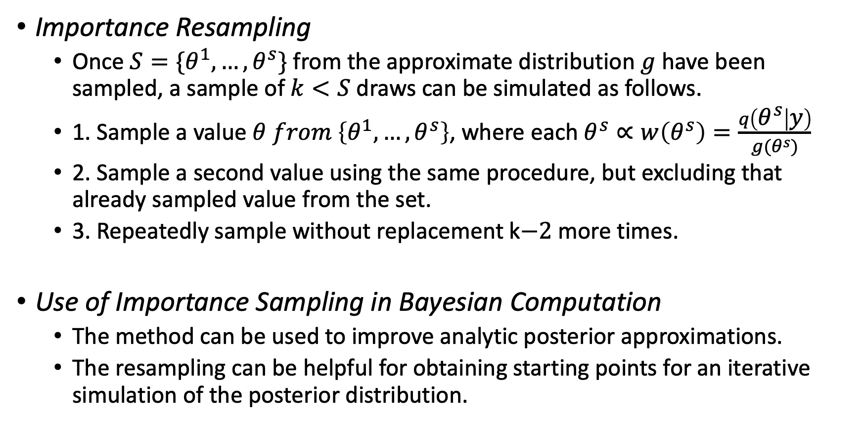
10.4 Importance Sampling
Importance Resampling
Once $S=\{θ^{1}, …, θ^{s}\}$ from the approximate distribution $g$ have been sampled, a sample of $k<S$ draws can be simulated as follows.
1. Sample a value $θ from \left\{θ^{1}, …, θ^{s}\right\}$, where each $θ^{s}∝w\left(θ^{s}\right)=\frac{q\left(θ^{s} | y\right)}{g(θ^{s})}$
2. Sample a second value using the same procedure, but excluding that already sampled value from the set.
3. Repeatedly sample without replacement k$−2$ more times.
Use of Importance Sampling in Bayesian Computation
The method can be used to improve analytic posterior approximations.
The resampling can be helpful for obtaining starting points for an iterative simulation of the posterior distribution.

Slide 25
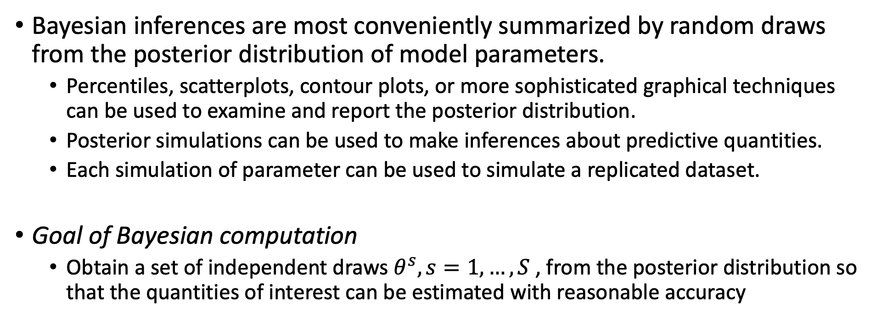
10.5 How many simulation draws are needed?
Bayesian inferences are most conveniently summarized by random draws from the posterior distribution of model parameters.
Percentiles, scatterplots, contour plots, or more sophisticated graphical techniques can be used to examine and report the posterior distribution.
Posterior simulations can be used to make inferences about predictive quantities.
Each simulation of parameter can be used to simulate a replicated dataset.
Goal of Bayesian computation
Obtain a set of independent draws $θ^{s}, s=1, …, S$ , from the posterior distribution so that the quantities of interest can be estimated with reasonable accuracy

Slide 26
Part III: Advanced Computation
Chapter 11 Basics of Markov chain simulation

Slide 27
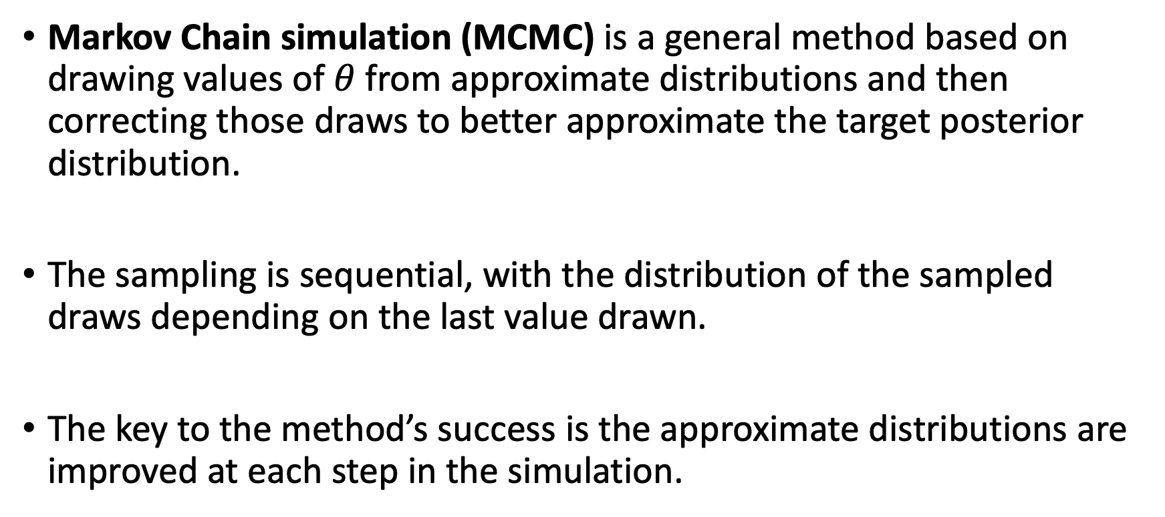
Basics of Markov Chain Simulation
Markov Chain simulation (MCMC) is a general method based on drawing values of $θ$ from approximate distributions and then correcting those draws to better approximate the target posterior distribution.
The sampling is sequential, with the distribution of the sampled draws depending on the last value drawn.
The key to the method’s success is the approximate distributions are improved at each step in the simulation.

Slide 28
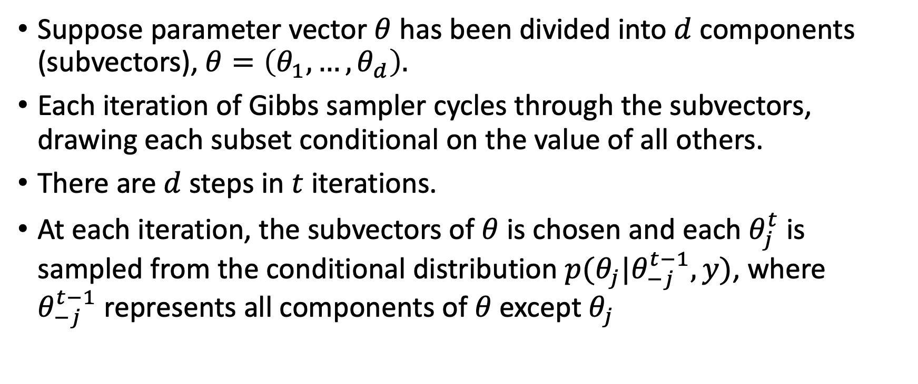
11.1 Gibbs Sampler
Suppose parameter vector $θ$ has been divided into $d$ components (subvectors), $θ=\left(θ_{1}, …, θ_{d}\right).$
Each iteration of Gibbs sampler cycles through the subvectors, drawing each subset conditional on the value of all others.
There are $d$ steps in $t$ iterations.
At each iteration, the subvectors of $θ$ is chosen and each $θ_{j}^{t}$ is sampled from the conditional distribution $p(θ_{j}|θ_{−j}^{t−1}, y)$, where $θ_{−j}^{t−1}$represents all components of $θ$ except $θ_{j}$

Slide 29
11.2 Metropolis and Metropolis-Hasting Algorithms
Metropolis-Hastings (MH) algorithm is a general Markov chain simulation methods for sampling from Bayesian posterior distributions.
Gibbs sampler is a special case of MH.

Slide 30
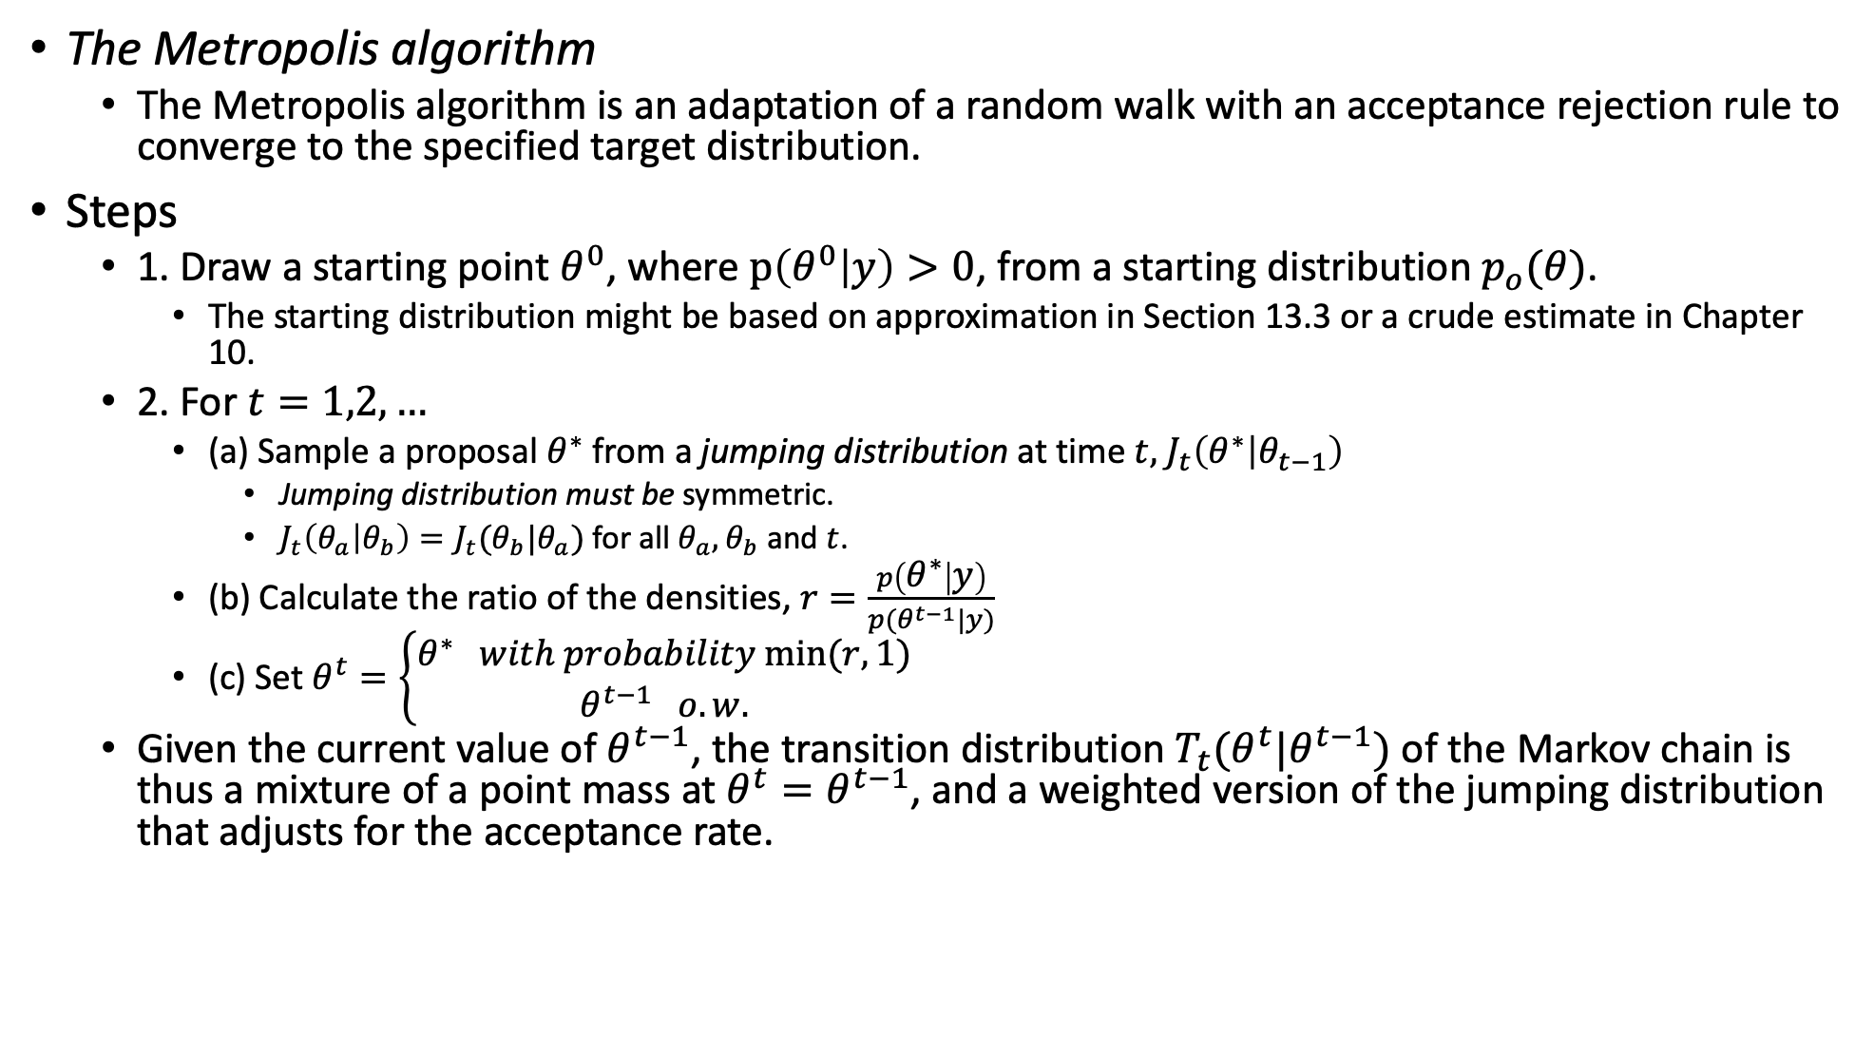
11.2 Metropolis and Metropolis-Hastings Algorithms
The Metropolis algorithm
The Metropolis algorithm is an adaptation of a random walk with an acceptance rejection rule to converge to the specified target distribution.
Steps
1. Draw a starting point $θ^{0}$, where $p\left(θ^{0} | y\right)>0$, from a starting distribution $p_{o}(θ)$.
The starting distribution might be based on approximation in Section 13.3 or a crude estimate in Chapter 10.
2. For $t=1,2,…$
(a) Sample a proposal $θ^{∗}$ from a jumping distribution at time $t,$ $J_{t}\left(θ^{∗} | θ_{t−1}\right)$
Jumping distribution must be symmetric.
$J_{t}\left(θ_{a} | θ_{b}\right)=J_{t}(θ_{b}|θ_{a})$for all $θ_{a}, θ_{b}$ and $t$.
(b) Calculate the ratio of the densities, $r=\frac{p\left(θ^{∗} | y\right)}{p(θ^{t−1}|y)}$
(c) Set $θ^{t}=\left\{\begin{aligned}θ^{∗} with probability min⁡(r, 1) \\ θ^{t−1} o.w.\end{aligned}\right.$
Given the current value of $θ^{t−1}$, the transition distribution $T_{t}(θ^{t}|θ^{t−1})$ of the Markov chain is thus a mixture of a point mass at $θ^{t}=θ^{t−1}$, and a weighted version of the jumping distribution that adjusts for the acceptance rate.

Slide 31
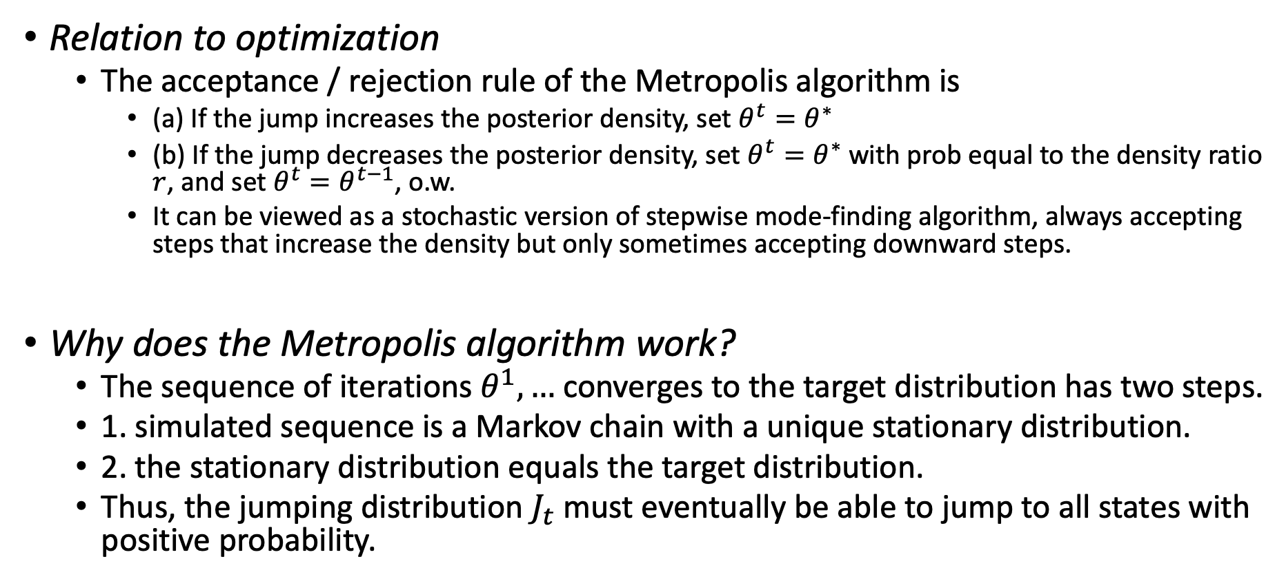
11.2 Metropolis and Metropolis-Hastings Algorithms
Relation to optimization
The acceptance / rejection rule of the Metropolis algorithm is
(a) If the jump increases the posterior density, set $θ^{t}=θ^{∗}$
(b) If the jump decreases the posterior density, set $θ^{t}=θ^{∗}$ with prob equal to the density ratio $r$, and set $θ^{t}=θ^{t−1}$, o.w.
It can be viewed as a stochastic version of stepwise mode-finding algorithm, always accepting steps that increase the density but only sometimes accepting downward steps.
Why does the Metropolis algorithm work?
The sequence of iterations $θ^{1},…$ converges to the target distribution has two steps.
1. simulated sequence is a Markov chain with a unique stationary distribution.
2. the stationary distribution equals the target distribution.
Thus, the jumping distribution $J_{t}$ must eventually be able to jump to all states with positive probability.

Slide 32
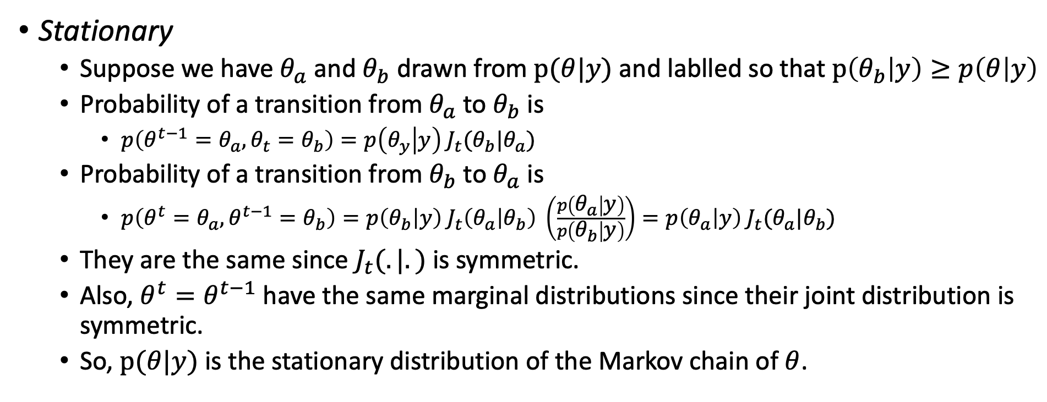
11.2 Metropolis and Metropolis-Hastings Algorithms
Stationary
Suppose we have $θ_{a}$ and $θ_{b}$ drawn from $p(θ|y)$ and lablled so that $p\left(θ_{b} | y\right)≥p\left(θ | y\right)$
Probability of a transition from $θ_{a}$ to $θ_{b}$ is
$p\left(θ^{t−1}=θ_{a}, θ_{t}=θ_{b}\right)=p\left(θ_{y} | y\right) J_{t}(θ_{b}|θ_{a})$
Probability of a transition from $θ_{b}$ to $θ_{a}$ is
$p\left(θ^{t}=θ_{a}, θ^{t−1}=θ_{b}\right)=p\left(θ_{b} | y\right) J_{t}\left(θ_{a} | θ_{b}\right) \left(\frac{p\left(θ_{a} | y\right)}{p\left(θ_{b} | y\right)}\right)=p\left(θ_{a} | y\right) J_{t}(θ_{a}|θ_{b})$
They are the same since $J_{t}(.|.)$ is symmetric.
Also, $θ^{t}=θ^{t−1}$ have the same marginal distributions since their joint distribution is symmetric.
So, $p(θ|y)$ is the stationary distribution of the Markov chain of $θ$.

Slide 33
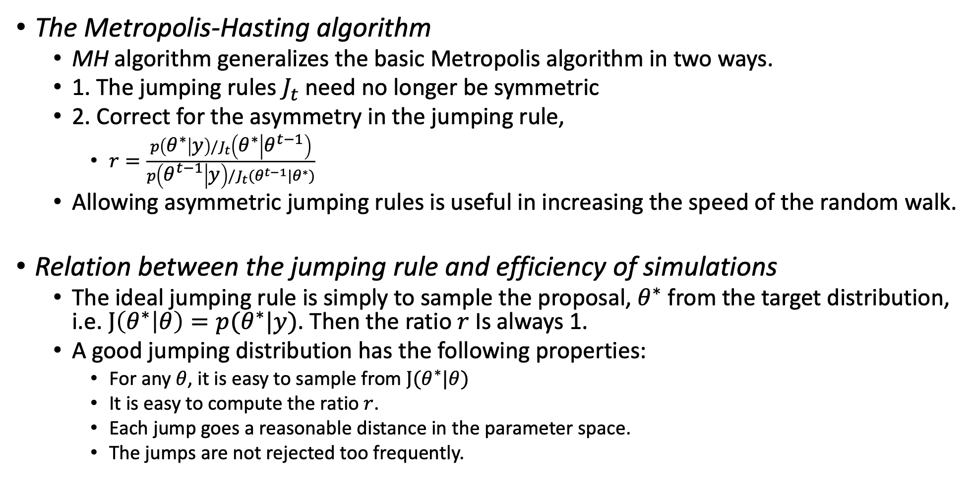
11.2 Metropolis and Metropolis-Hastings Algorithm
The Metropolis-Hasting algorithm
MH algorithm generalizes the basic Metropolis algorithm in two ways.
1. The jumping rules $J_{t}$ need no longer be symmetric
2. Correct for the asymmetry in the jumping rule,
$r=\frac{p\left(θ^{∗} | y\right)/J_{t}\left(θ^{∗} | θ^{t−1}\right)}{p\left(θ^{t−1} | y\right)/J_{t}(θ^{t−1}|θ^{∗})}$
Allowing asymmetric jumping rules is useful in increasing the speed of the random walk.
Relation between the jumping rule and efficiency of simulations
The ideal jumping rule is simply to sample the proposal, $θ^{∗}$ from the target distribution, i.e. $J\left(θ^{∗} | θ\right)=p(θ^{∗}|y)$. Then the ratio $r$ Is always 1.
A good jumping distribution has the following properties:
For any $θ$, it is easy to sample from $J(θ^{∗}|θ)$
It is easy to compute the ratio $r$.
Each jump goes a reasonable distance in the parameter space.
The jumps are not rejected too frequently.

Slide 34
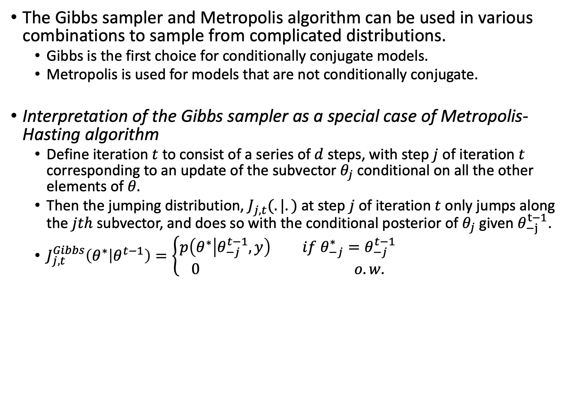
11.3 Using Gibbs and Metropolis as building blocks
The Gibbs sampler and Metropolis algorithm can be used in various combinations to sample from complicated distributions.
Gibbs is the first choice for conditionally conjugate models.
Metropolis is used for models that are not conditionally conjugate.
Interpretation of the Gibbs sampler as a special case of Metropolis-Hasting algorithm
Define iteration $t$ to consist of a series of $d$ steps, with step $j$ of iteration $t$ corresponding to an update of the subvector $θ_{j}$ conditional on all the other elements of $θ.$
Then the jumping distribution, $J_{j, t}(.|.)$ at step $j$ of iteration $t$ only jumps along the $jth$ subvector, and does so with the conditional posterior of $θ_{j}$ given $θ_{−j}^{t−1}$.
$J_{j, t}^{Gibbs}\left(θ^{∗} | θ^{t−1}\right)=\left\{\begin{aligned}p\left(θ^{∗} | θ_{−j}^{t−1}, y\right) if θ_{−j}^{∗}=θ_{−j}^{t−1} \\ 0 o.w.\end{aligned}\right.$

Slide 35
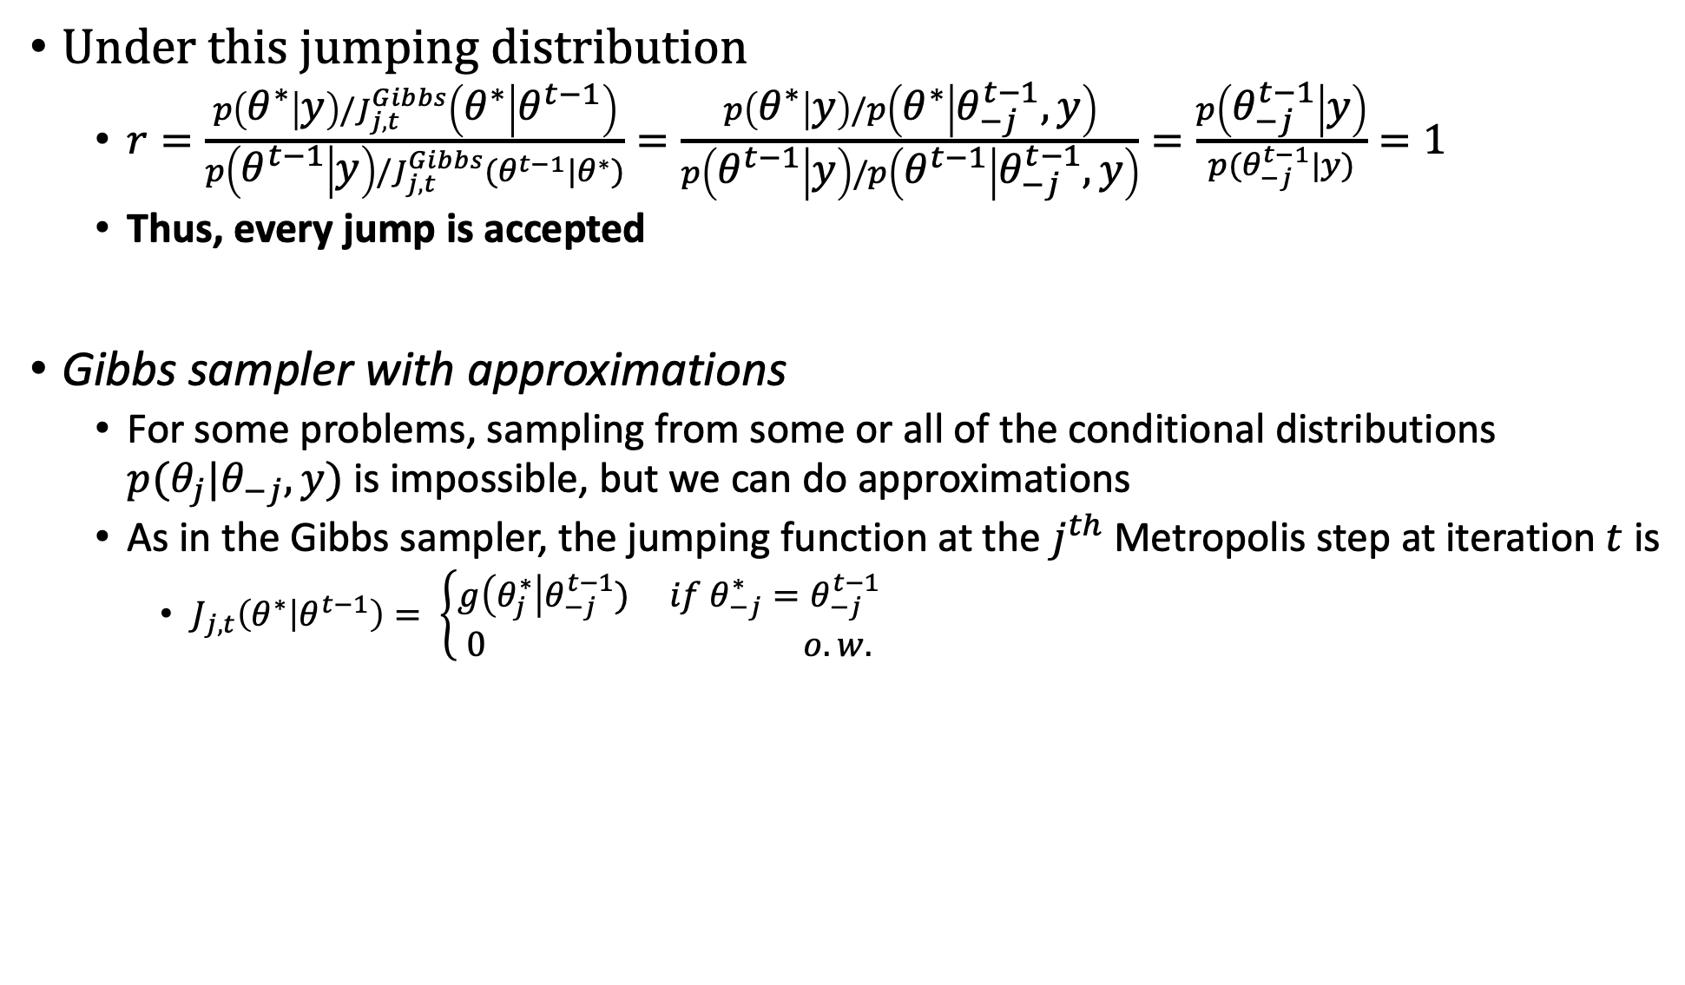
11.3 Using Gibbs and Metropolis as building blocks
Under this jumping distribution
$r=\frac{p\left(θ^{∗} | y\right)/J_{j, t}^{Gibbs}\left(θ^{∗} | θ^{t−1}\right)}{p\left(θ^{t−1} | y\right)/J_{j, t}^{Gibbs}(θ^{t−1}|θ^{∗})}=\frac{p\left(θ^{∗} | y\right)/p\left(θ^{∗} | θ_{−j}^{t−1}, y\right)}{p\left(θ^{t−1} | y\right)/p\left(θ^{t−1} | θ_{−j}^{t−1}, y\right)}=\frac{p\left(θ_{−j}^{t−1} | y\right)}{p(θ_{−j}^{t−1}|y)}=1$
Thus, every jump is accepted
Gibbs sampler with approximations
For some problems, sampling from some or all of the conditional distributions $p(θ_{j}|θ_{−j}, y)$ is impossible, but we can do approximations
As in the Gibbs sampler, the jumping function at the $j^{th}$ Metropolis step at iteration $t$ is
$J_{j,t}\left(θ^{∗} | θ^{t−1}\right)= \left\{\begin{aligned}g\left(θ_{j}^{∗}\right|θ_{−j}^{t−1}) if θ_{−j}^{∗}=θ_{−j}^{t−1} \\ 0 o.w.\end{aligned}\right.$

Slide 36
11.4 Inference and Assessing Convergence
Difficulties of inference from iterative simulation
1. The iterations must be long enough for the convergence and the early iterations are useless.
2. Correlation can cause inefficiencies in simulations.
Discarding early iterations of the simulation runs
To diminish influence of the starting value
Discard the first half of each sequence and focus attention on the second half.
We refer to the practice of discarding early iterations in Markov chain simulation as warm-up.

Slide 37
11.4 Inference and Assessing Convergence
Dependence of the iterations in each sequence
Once approximate convergence has been reached, should we thin the sequence by keeping every kth simulation draw from each sequence and discarding the rest?
When the sequences have reached approximate convergence, then they can be used.
Multiple sequences with overdispersed starting points
We can compare different simulated independent sequence to see whether it converges.

Slide 38
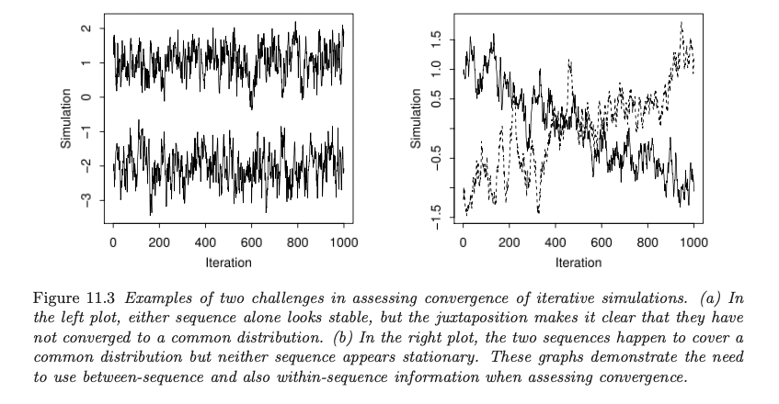
11.4 Inference and Assessing Convergence
Challenges of monitoring converge: mixing and stationarity

Slide 39
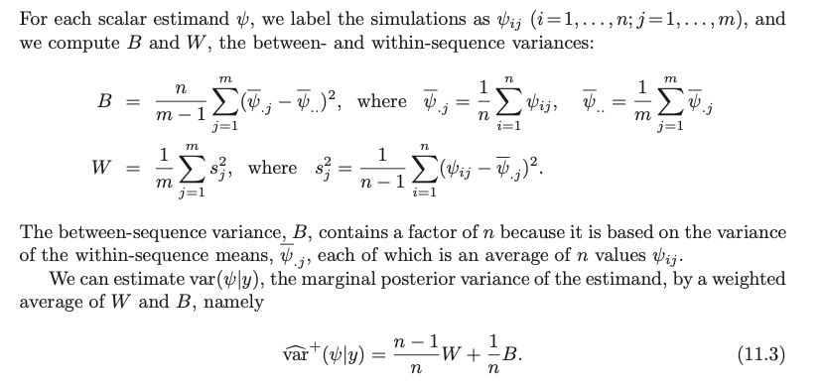
11.4 Inference and Assessing Convergence
Apart from checking within and between sequence plots, we can also calculate variances.

Slide 40



11.5 Effective number of simulation draws
Once the sequences have mixed, we can compute an approximate “effective number of independent simulation draws” for our interest.
One way is by consider the average of the simulations as an estimate of the posterior mean, then the effective sample size is

Slide 41
Part III: Advanced Computation
Chapter 12 Computationally efficient Markov chain simulation

Slide 42
Tbc…

Slide 43
Trace Through the Code
Construct the prior for the variance of z
These priors are based on direction, so there are 47 + 50 parameters.
Update the parameters by sampling the noise based on the

